Slide 1
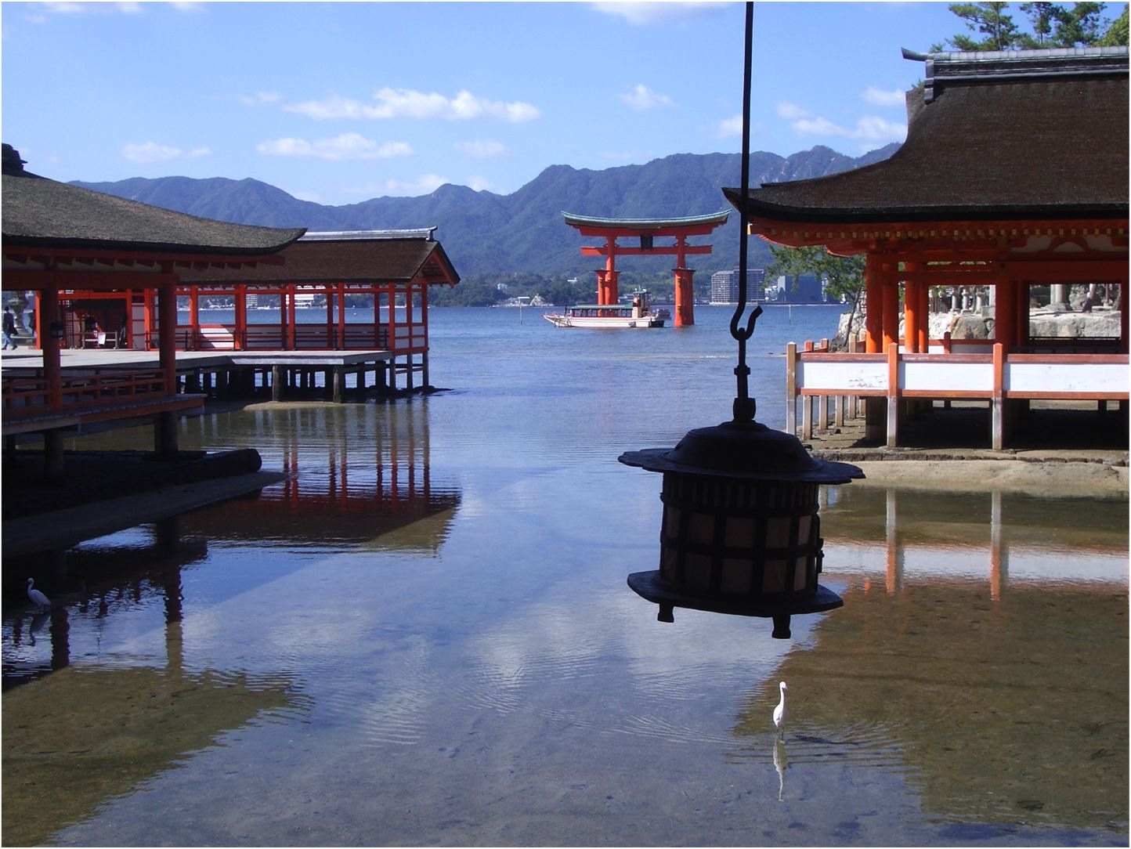
Preparing for Japan
Dr Chris Pearson
RAL Space, Rutherford Appleton Laboratory, UK
chris.pearson@stfc.ac.uk
JSPS Fellowship 1999-2001

Slide 2
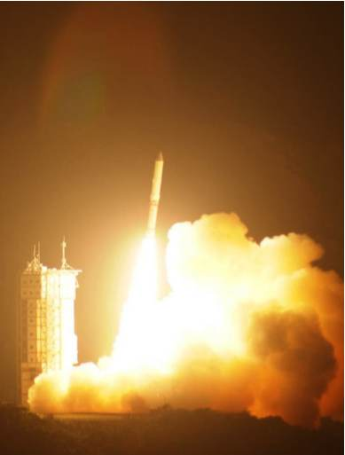
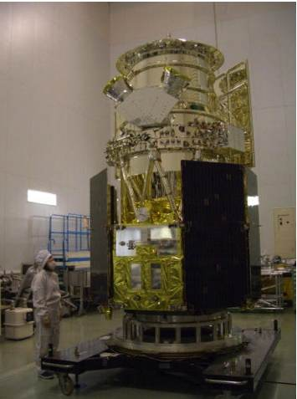
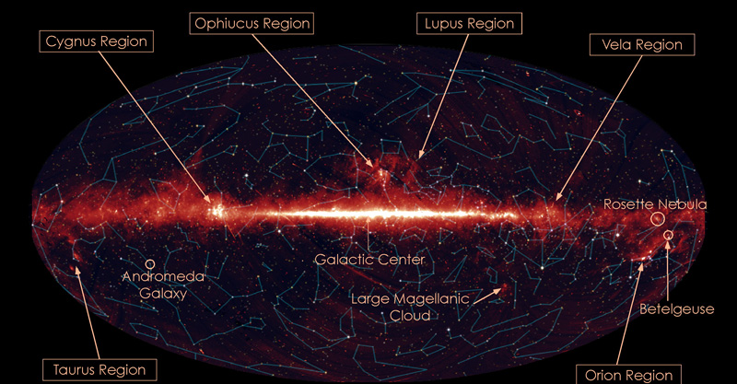
My Research Background
Cosmology and Astrophysics
Survey strategy and planning for space telescopes
Japanese AKARI mission (launched 2006)
European Herschel Mission (launched 2009)
Japanese/European SPICA Mission (launch 2018)
Institutes
  Institute for Space and Astronautical Science
  Japan Aerospace Exploration Agency
  European Space Agency
  Canadian Space Agency
  RAL Space, UK
Notes:
My experience :

Slide 3
My Connection to Japan
Long Connection with Japanese science and education
1997: Monbusho Scholarship for Foreign Researchers
1999: JSPS Fellowship to Japan
2002: Japan-UK N+N collaboration participant
2001: Royal Society Joint Projects Award with Japan
2004: Daiwa Adrian £10K Prize Member
2003: Royal Society Joint Projects Award with Japan
2003: Fellowship from European Commission to Japan
2005: JSPS Invitation Fellowship
2006: European Space Agency Support Astronomer in Japan
2006: British Council Lecture series for Japanese school children
2006: Royal Society Joint Projects Award with Japan
2008: JSPS Furasato Award to Japan
2010: Committee board member for tenure staff at Nagoya University
2010: JSPS Bridge Fellowship to Japan
2010: JSPS Core-to-Core participant
2010: Japanese Translator for European Space Agency
Notes:
My experience :

Slide 4
Challenges
Culture:
  Completely new culture and working environment
  Foreigners still relatively rare but well received
Communication
  Japanese can speak English but often do not
  American English is learned in schools
  Fluency is directly proportional to quantity of drink
Language
  Japanese is one of the most difficult modern languages
  A mix of 4 different scripts
  Steep learning curve but benefits are immense
Navigation
  Great train system
  Cities can be complicated
  Driving is not difficult
  Local not referred to by name but rather 3 coordinates
Notes:
My experience :
Japanese people may run away if you try and ask in English and then stop relieved if Japanese comes out of your mouth.
Even if you are speaking Japanese it still takes a while for people to click that you ARE actually speaking Japanese.
“maybe” or “its difficult” means NO !

Slide 5
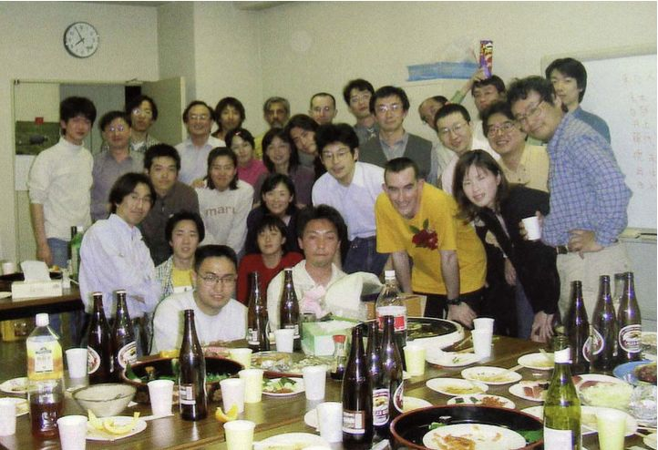
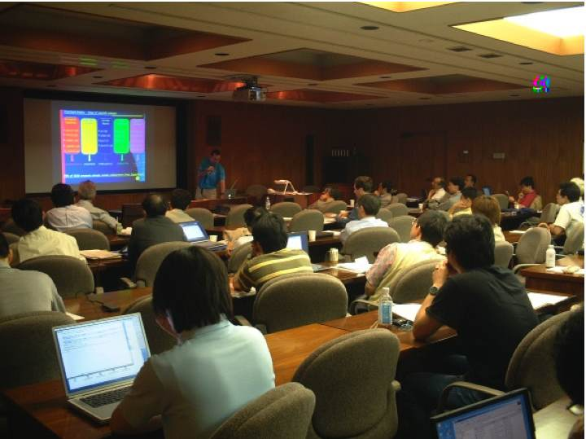
Working Conditions
Great facilities
Very helpful staff
Hours depend on institute
English content varies
The grad students know the truth
Can take some time to break into the research circle
Output from your fellowship depends on you !
Notes:
My experience :
Remember you are NOT Japanese and Japanese know you are not.
Work hard …. BUT You do not have to follow the same work ethic, etc

Slide 6
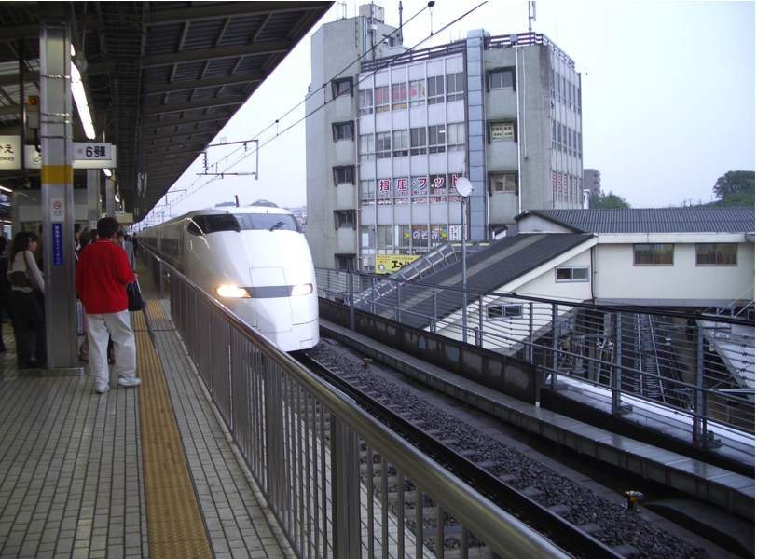
Transport
Excellent punctual rail system
  National JR, Private lines
  Shinkansen
Buses
  a little complicated
Bicycles numerous
  Cheap, convenient
  ride on the pavement
Taxi
  Expensive & often need a map
  Can use credit card / sometimes translation available
Cars
  Hire car with UK driving licence or drive with international licence
  2nd hand cars cheap
  Petrol stations not self service
Notes:
My experience :
Railways: JR, Private , Suica

Slide 7
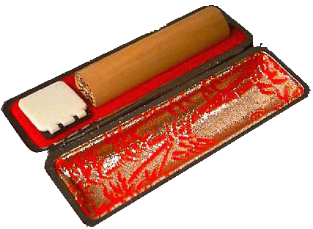
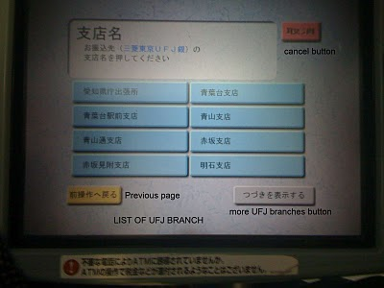
Money & Banking
Cash orientated society (very safe with very little crime)
ATM not open 24 hrs (charge in evening/weekends/holidays)
ATM in convenience stores (expensive charges)
Post Office ATM accepts foreign bank cards
Using Credit Card or T/C - No guarantee
Take some money with you in case of delays
Foreigners can easily open a bank account but often requires hanko, gaijin card, etc
Credit cards available but need a bank account
In the bank take a ticket and wait to be called
International transfers possible
Notes:
Citi Bank / HSBC exist but rare
International transfers – get a video screen

Slide 8
Accommodation
Institute accommodation
  Cheap, close to work, no admin, no language problem
  Limited duration, no culture immersion
Weekly / monthly mansion (or gaijin house)
  Flexible contracts, furnished
  no culture immersion
Rented accommodation (usually unfurnished)
6 months, 1 year, 2 year contracts
Mansion
  relatively expensive
  newer
  warmer
  concrete
Apartment (a-pa-to)
  relatively cheap
  older
  colder
  Wood structure
Notes:
My experience :
I have lived in institute, mansions and apartment and recommend a mansion

Slide 9
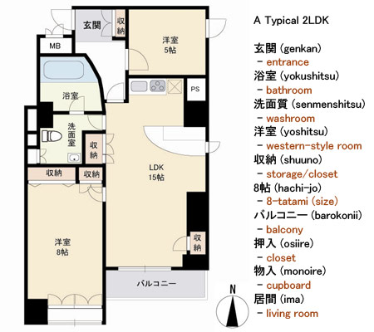
Renting a place to live
Renting from a Real-Estate agent : fu-do-san-ya
  Apartment rated by rooms (3DK, 2LDK, 2K, 1DK, 1K, ……..)
  Room size in number of mats
Need a guarantor & always best to go with Japanese colleague
Initial cost is expensive
  deposit money (1 month)
  gift/key money (1-2 months)
  advance rent (1-2 months)
Total ~ 5 months advance
after moving
  Call up gas / electric / water companies
  Check rubbish recycling days
  Some apartment blocks will already have internet / satTV
Go and buy your furniture
Notes:
My experience :
not easy for foreigner to rent,
No English
Some fudosanya have signs welcoming foreigners
Apartment blocks quite private (don’t expect to see neighbors)
Apartments almost always unfurnished
recycle shops
100 yen shops
retail stores (Jusco, ito yo-kado)
Electrical stores (Yodobashi, Kojima)
department stores (very expensive)

Slide 10
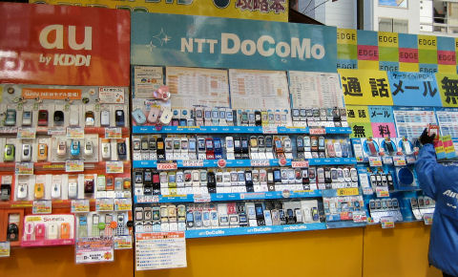
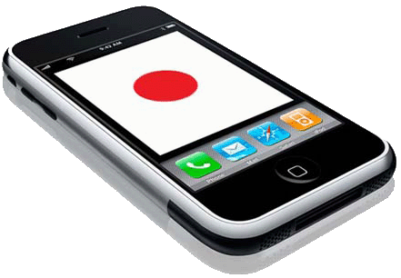
Mobile Phones
Total mobile phone culture
6 month, 1 year contracts
English phones available
Require passport, gaijin card, hanko ?
Short term: rent at airport
Using your own U.K. phone
  Roaming expensive, need a 3G phone, Quad band no good
Notes:
My experience : Don’t use Soft Bank

Slide 11
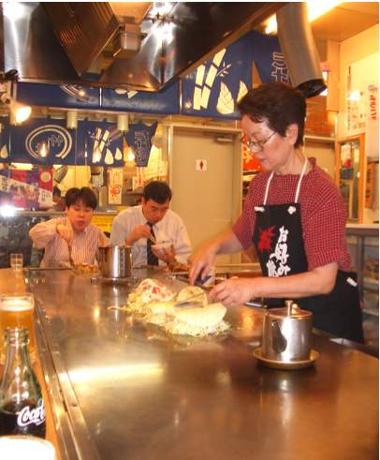
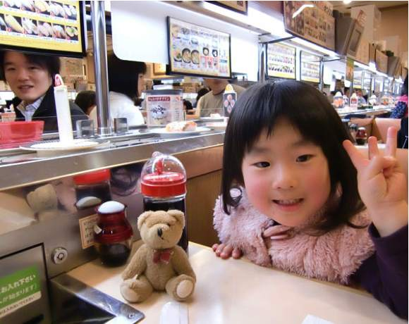
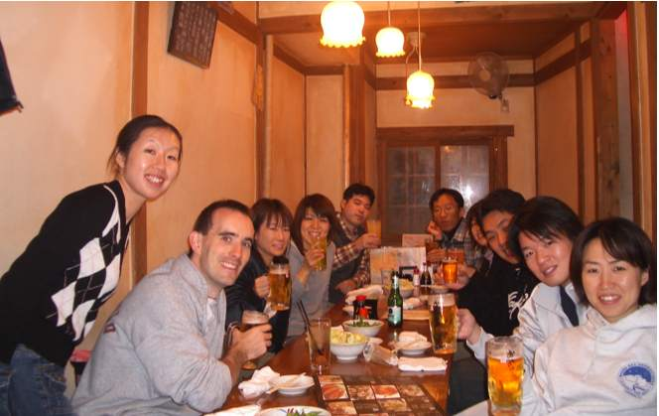
Eating Out
Wide variety of exciting food
Can eat cheaply (Katsuya, Yoshinoya, Kaiten Sushi)
Can try traditional expensive restaurants
Restaurants have pictures/plastic models of food
Some restaurants will have English menus
Learning Katakana can help a lot
Notes:
My experience :

Slide 12
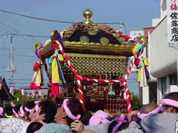
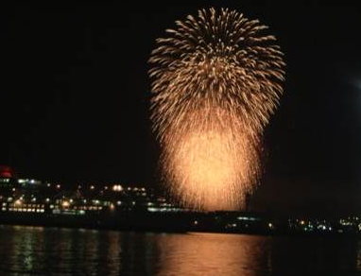
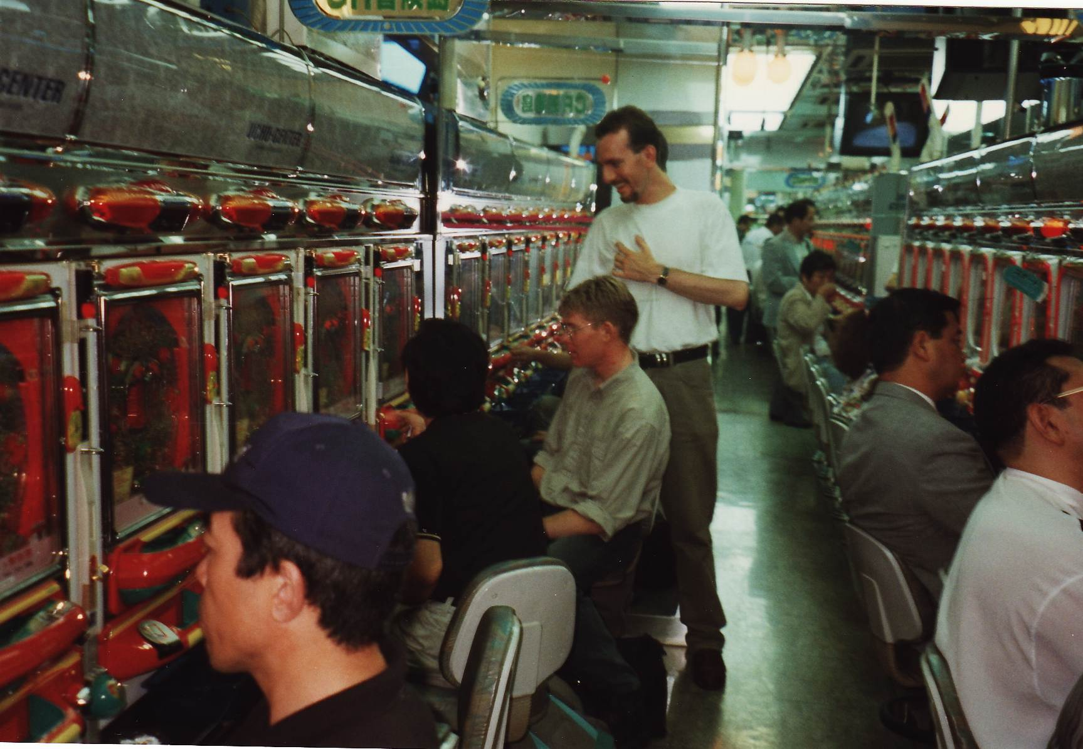
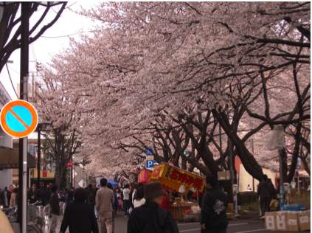
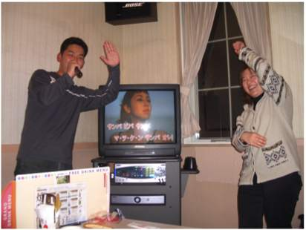
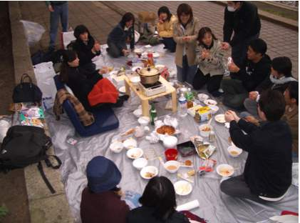
Leisure
Traditional Japanese events
  Matsuri
  Hanami (cherry blossom viewing)
  Hanabi (fireworks)
  Beer Gardens
  Pachinko
  Onsen
For traditional Japanese pastimes try;
  Culture centres (bunka centre)
  International Lounge
  Japanese Schools
Notes:
My experience :

Slide 13
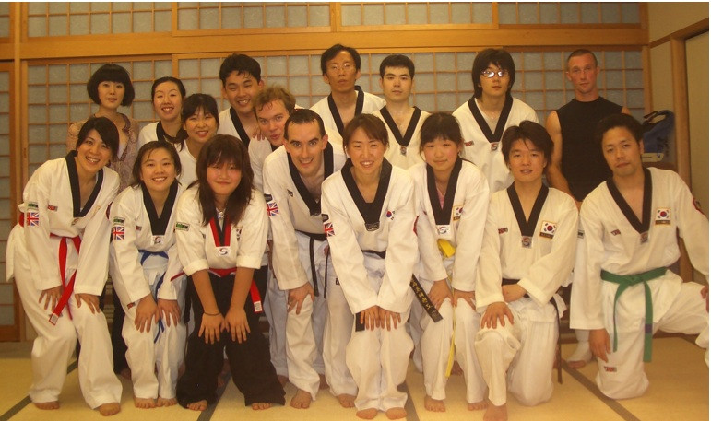
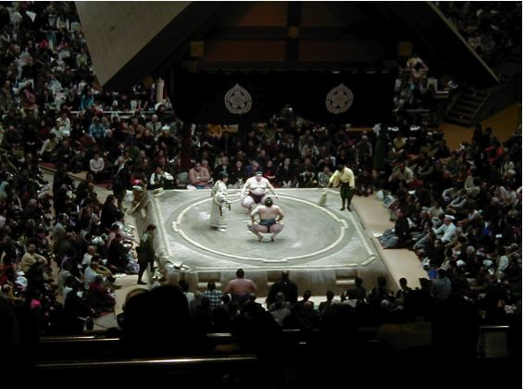
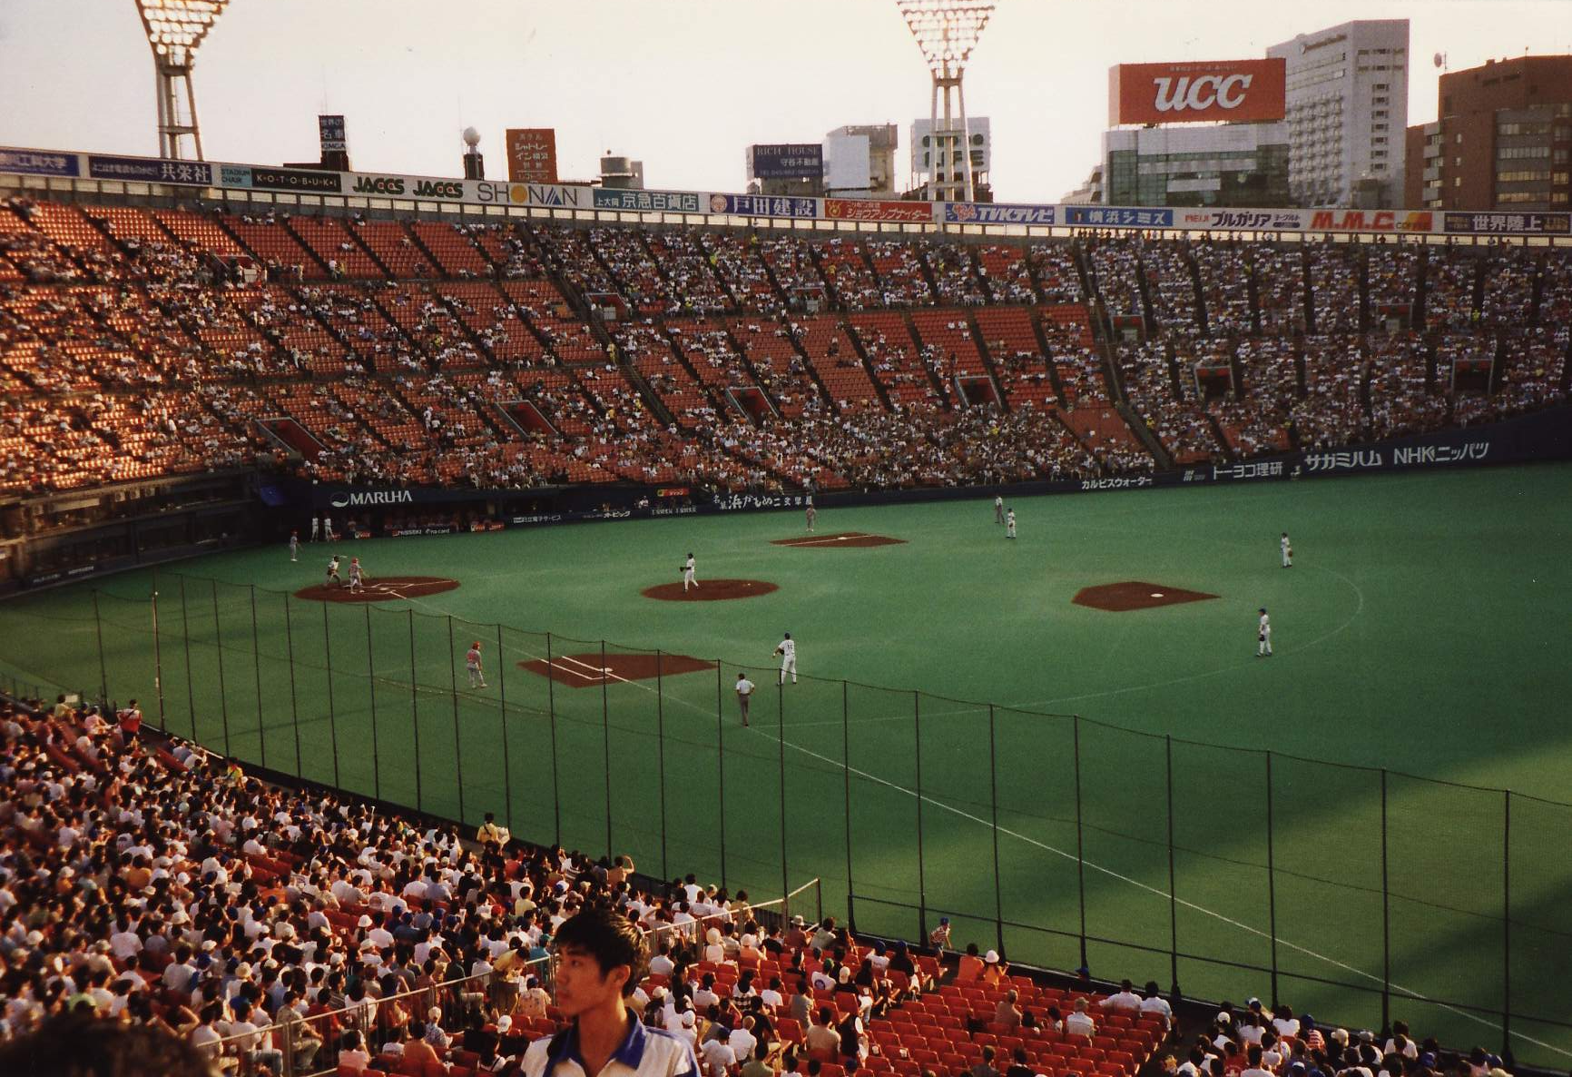
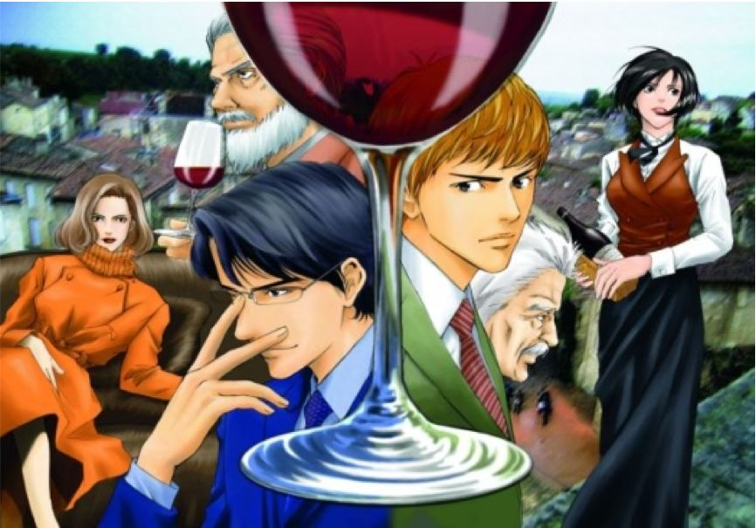
Leisure
Traditional Sports
  Martial Arts
  Baseball
  Sumo
Cultural Pursuits
  Kabuki
  Tea ceremony
  Music
  Shodo (Calligraphy)
  Manga
Notes:
My experience :
All the familiar pastimes are there – cinema, sports club , gym, night clubs

Slide 14




Language
Learn Japanese !!
  Katakana
  Hiragana
  Kanji (first 50)
JSPS often provide generous expenses for Japanese tuition – USE IT !
  Commercial schools
  Private 1-2-1 lessons
  YMCA
  International Lounge
  Friends
Make Japanese friends
Put yourself in a position where you have to try and speak
For the more courageous JLPT exams (Level 5, 4)
Notes:
My experience :
Private lessons cover more but are ridiculusly expensive
Class lessons are cheaper and you will make friends but progress can be slow

Slide 15
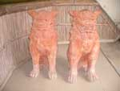
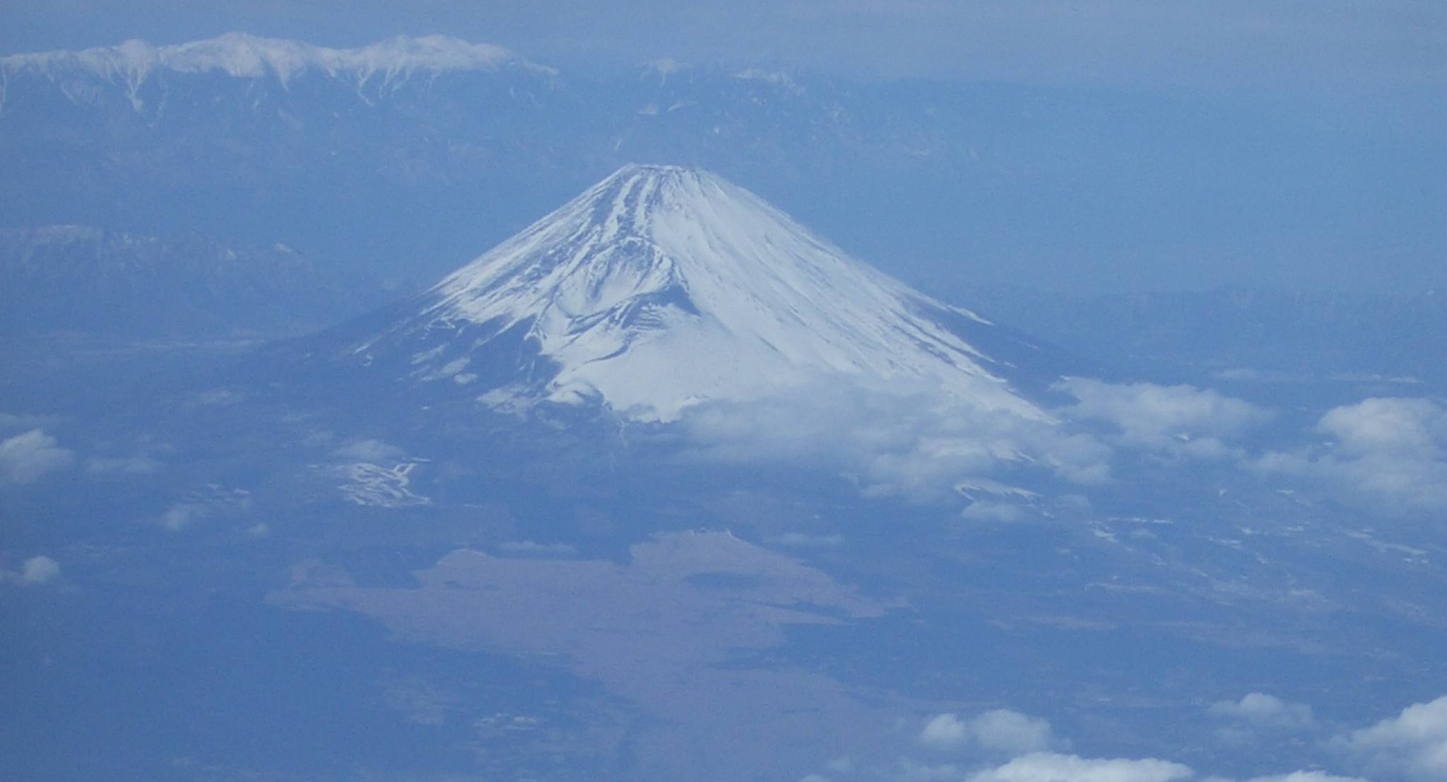
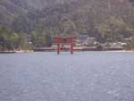
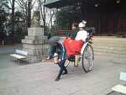
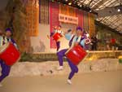
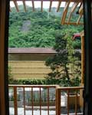
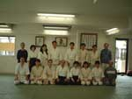
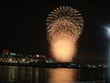
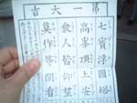
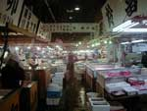
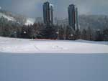
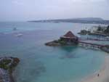
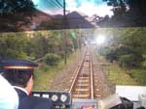
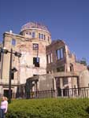
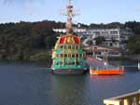
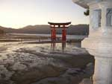
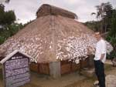
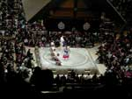
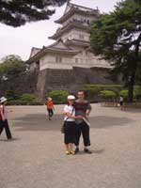
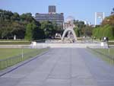
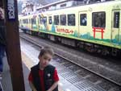
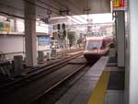
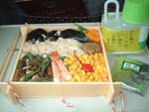
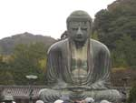
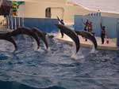




Sightseeing
Notes:
My experience :

Slide 16
Top 5 Do’s and Don’t’s
DO !
  Learn the language and you will understand the culture.
  Make Japanese friends
  Enjoy an activity outside of work
  Travel to see Japan
  Build many contacts during your work
DO NOT !
  Just associate with foreign friends
  Work by yourself (a career black hole)
  try to be Japanese
  spend every waking hour at your workplace
  Expect everyone to understand or speak English
Notes:
My experience :

Slide 17

Future Collaboration
How to maintain collaboration with Japanese colleagues after your visit?
  The purpose of you visit should not be definitive
  Your visit should be a building process
  It’s a chance to initiate research projects
  It’s a chance to begin drafting of papers
JSPS provides opportunities to maintain connections
  Short term visits
  Fellowships
  Furasato Awards
  Bridge Fellowships
  Symposium support scheme
Your JSPS Fellowship gives you the unique opportunity to become a bridge between your U.K. and Japanese institutes for future collaboration
Notes:
My experience :

